Slide 1
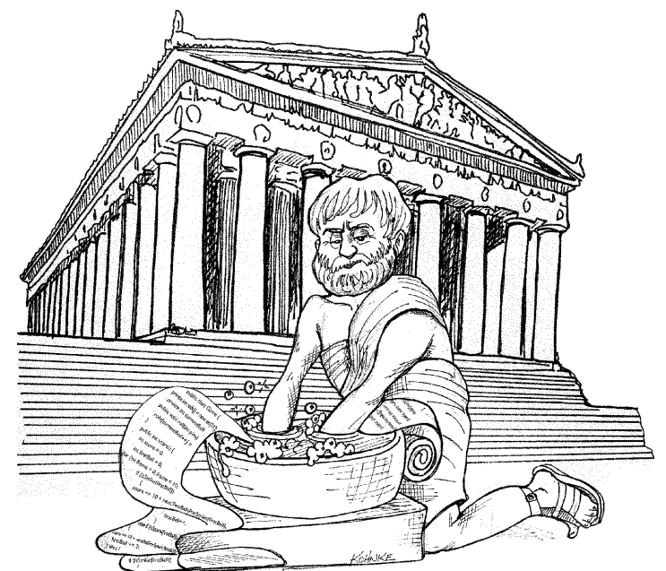
Clean Code
Notes:
You are attending this presentation two reasons. First, you are a programmer. Second, you want to be a better programmer. Good. We need better programmers.

Slide 2
Agenda
Introduction
Names
Review

Slide 3
Introduction

Slide 4
Clean code
"Have you ever been significantly impeded by bad code?
So - why did you write it?"

Slide 5
Why?
software rots over time
excuses
requirements changed (code should be easy to change)
tight schedules (bad code == more delay)
ratio of time spent reading vs. writing is over 10:1
unclean code costs you
harder to maintain (even by the original developer)
harder to add features
harder to change without introducing defects
can bring a company down

Slide 6
Why? (continued)
quick workarounds are debts for which you pay interest
temporary workarounds are not temporary most of the time
constant care and effort is needed to keep code clean

Slide 7
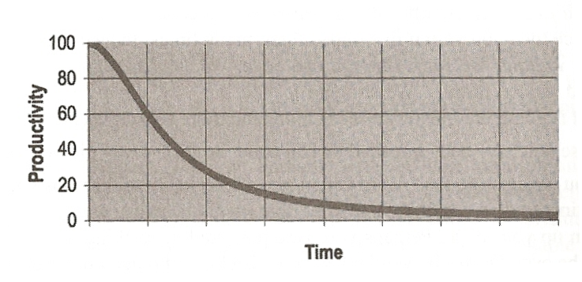
Productivity vs. time

Slide 8
Clean code
Any fool can write code that a computer can understand. Good programmers write code that humans can understand.
Martin Fowler

Slide 9
What is clean code?
minimal dependencies
clean and minimal API
simple and direct (not cleaver!)
looks like it was written by someone who cares
Principle of least astonishment:
"You know you are working on clean code when each routine you read turns out to be pretty much what you expected. You can call it beautiful when the code also makes it look like the language was made for the problem"
Ward Cunningham
Notes:
not cleaver: you can be a smart developer and still write really dirty code. Don't try to write smart code – try to write code that is easily understood.

Slide 10
What is clean code? (continued)
In simpler words:
Writing clean code is a learnable communication skill.

Slide 11

Names

Slide 12
Use Intention-Revealing Names
takes time but save more time
the name should say:
why it exist
what it does
how is used
if a name requires a comment then the name doesn't reveal its intent
int d; // elapsed time in days

Slide 13
Use Intention-Revealing Names (continued)
public List<int[]> getThem() { List<int[]> list1 = new ArrayList<int[]>(); for (int[] x : theList) if (x[0] == 4) list1.add(x); return list1; }
Why is it hard to tell what this code is doing?
Notes:
There are no complex expressions. Spacing and indentation are reasonable. There are only three variables and two constants mentioned. There aren’t even any fancy classes or polymorphic methods, just a list of arrays (or so it seems).
To understand this code we need to know:
1. What kinds of things are in the list? 2. What is the signiﬁcance of the zeroth subscript of an item in the list? 3. What is the signiﬁcance of the value 4? 4. How would I use the list being returned?
The answers to these questions are not present in the code sample, but they could have been.

Slide 14
Use Intention-Revealing Names (continued)
public List<int[]> getFlaggedCells() { List<int[]> flaggedCells = new ArrayList<int[]>(); for (int[] cell : gameBoard.getCells()) { if (cell[STATUS_VALUE] == FLAGGED) { flaggedCells.add(cell); } } return flaggedCells; }
Minesweeper improved version
Notes:
Here is what introducing a few names can do (renames, introduce constants)

Slide 15
Use Intention-Revealing Names (continued)
public List<Cell> getFlaggedCells() { List<Cell> flaggedCells = new ArrayList<Cell>(); for (Cell cell : gameBoard.getCells()) { if (cell.isFlagged()) { flaggedCells.add(cell); } } return flaggedCells; }
Minesweeper final version
Notes:
Changes:
- encapsulating the array, to be able to give it a name and have methods on it
- encapsulating the condition

Slide 16
Names should provide enough explanation
Which is better?
Date newDate = date.add(5); OR Date newDate = date.addDays(5);
private final long elapsedTime; OR private final long elapsedTimeInMillis;

Slide 17
Encapsulate data structures
private final
Map<ObjectName,Map<String,List<String>>> myRefedMBeanObjName2RelIdsMap = new...
Notes:
Why is this difficult to understand?
- what does the String key represent?
- what does each element in the list of String represent?
- what does the list of String represent? why is a list and not a Set?
- what does the inner map represents?
The problem is that we have multiple anonymous data structures – without a name. If we encapsulate these data structures into classes, then we have something to which we can give a good name, that explain what it represents.

Slide 18
Encapsulate data structures (continued)
private final
Map<ObjectName, RelationRoles> myRefedMBeanObjName2RelIdsMap = new...
Notes:
By encapsulating the nested map to a class, I now have an entity to which I can give a good name. The names of the methods in that class will give further information about what the class does.

Slide 19
Encapsulate data structures (continued)
// Map associating: // <ObjectName> -> HashMap // the value HashMap mapping: // <relation id> -> ArrayList of <role name> // to track where a given MBean is referenced. private final Map<ObjectName,Map<String,List<String>>> myRefedMBeanObjName2RelIdsMap = new...
Notes:
The code actually looks like this. The comment answers our initial questions, but a comment is a workaround in this case.
Try to write code so that comments become unnecessary.
Hints that the code is not clean:
- too complicated data structure
- the name of the field: you can see it's doing too much
- the comment: if we refactor the code, the comment becomes largely unnecessary

Slide 20
Encapsulate complicated conditions
if (geoLocation.getLatitude() != null
&& geoLocation.getLatitude() > MIN_VALID_LATITUDE
&& geoLocation.getLongitude() != null
&& geoLocation.getLongitude() > MIN_VALID_LONGITUDE
&& geoLocation.getRadius() != null
&& isWithinNetherlands(geolocation)) { // ... }
Notes:
One of the checks is whether the location is within Netherlands. Note that the rest of the conditions make this check hard too see.

Slide 21
Encapsulate complicated conditions (continued)
if (geoLocation.isValid()
&& isWithinNetherlands(geolocation)) { // ... }
Notes:
By encapsulating the condition in a method, we were able to introduce a good explanatory name.

Slide 22
Explanatory variables
Matcher matcher = headerPattern.matcher(line); if (matcher.find()) { final String name = matcher.group(1); final String value = matcher.group(2); headers.put(name, value); }
Notes:
By introducing the variables "name" and "value" it's now clear what the first and the second capturing group represents.

Slide 23
Avoid Disinformation
Naming grouping of accounts as accountsList when it's not of type java.util.List
Beware of using names which vary in small ways.
XyzControllerForEfficientHandlingOfStrings
XyzControllerForEfficientStorageOfStrings
Unexpected side effects
person.getName() making a web service call
myStack.pop() not removing the element from the stack

Slide 24
Make Meaningful Distinctions
/** * @param a1 source * @param a2 destination */ public static void copyChars(char[] a1, char[] a2) { for (int i = 0; i < a1.length; i++) { a2[i] = a1[i]; } }
Notes:
Many times, such a commentary is missing.

Slide 25
Make Meaningful Distinctions (continued)
public static void copyChars(char[] source, char[] destination) { for (int i = 0; i < source.length; i++) { destination[i] = source[i]; } }
Notes:
Now it's very clear what is the difference between the two parameters, even if they have the same type.
Also notice how the comment is no longer needed and we were able to remove it.
This is a good thing.
Code should be self-documented wherever possible (complicated algorithms are one of the exceptions).

Slide 26
Make Meaningful Distinctions (continued)
Avoid noise words
Product
ProductData
Better
ProductEntity
ProductDto

Slide 27
Use pronounceable names
genymdhms()
generate date, year, month, day, hour, minute, and second
better: generateTimestamp()
Don't use abbreviations
Mgr
Itrt
jis
FRSK

Slide 28
Don't capitalize abbreviations/acronyms
Which is easier to read:
HTTPURLConnection
HttpUrlConnection
The second alternative also helps with autocomplete and go-to-class in IDEs (just type HUC).

Slide 29
Use Searchable Names
int s = 0; for (int i = 0; i < t.length; i++) { s += (t[i] * 4) / 5; }
OR
int sum = 0; for (int i = 0; i < taskEstimates.length; i++) { int realTaskDays = taskEstimates[i] * REAL_DAYS_PER_IDEAL_DAY; int realTaskWeeks = realTaskDays / DAYS_PER_WEEK; sum += realTaskWeeks; }
Notes:
It's very likely that 5 is also used in other parts of the code with different meanings.
Without the constants, to check where the number of days per week is used in the codebase, you would need to search for "5" and manually inspect all occurrences to exclude those that do not represent the number of days per week. That's a lot of wasted time.

Slide 30
Avoid mental mapping
generally, use domain language consistently
don't invent terms outside of the domain language, even if they are clearer
Notes:
For aspect-oriented programming, Spring Framework could have invented something better than pointcut, joinpoint, or advice. But those names are already established, and introducing others would just make thing worse, because developers would have needed to constantly translate between the 2 terminologies.

Slide 31
Be consistent
don't use fetch(), retrieve(), get(), and load() in different classes if they do similar actions (e.g. loading data from a database).

Slide 32
Class Names
noun or noun phrase (a "thing")
Customer, WikiPage, Account, AddressParser
a class name should not be a verb (e.g.: Executor not Execute)

Slide 33
Interface Names
noun or noun phrase (a "thing") when it describes the main responsibility of the implementer class
List, ExecutorService
adjective or adjective phrase (a "characteristic") when it describes an additional capability of the implementer class
Comparable, Serializable

Slide 34
Method Names
verb or verb phrase (an "action")
postPayment(), deletePage(), save()
replace multiple constructors with static factory methods
Complex left = new Complex(23.0); Complex right = new Complex("23.0 - 5i");
Better:
Complex left = Complex.fromReal(23.0); Complex right = Complex.parseString("23.0 - 5i");
Notes:
The static factory methods gives us an entity which we can name and use this name to explain what it does.
You can also have 2 factory methods with the same signatures (because you can give them different names), but this is not possible with constructors.

Slide 35
Don’t be cute
don't use the name whack() to mean kill()

Slide 36
Difficulties finding a name
may be an indicator that the class/method has too many responsibilities
split into multiple classes/methods

Slide 37
Review
Clean code is about communication
Names are a very important communication tool
it's worth taking the time to find a good name
Replace anonymous constructs with named ones
Refactor code to minimize the need for comments
Notes:
Replacing anonymous constructs (magic numbers, complicated expressions, code blocks, etc.) with named constructs allows you to give them a name that explains what they are doing, improving communication.

Slide 38
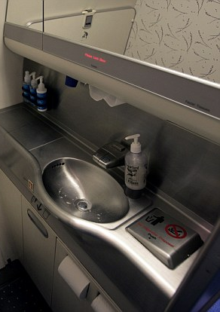
Conclusion
"As a courtesy to the next passenger, please clean the sync"
Notes:
I would say: "As a courtesy to the next developer, please clean the code". Thus you show kindness to your fellow developer, to your manager, and to your client. And is the only professional thing to do.
Thank you for participation.

Slide 39
Presentation available online
https://github.com/cvmocanu/clean-code-presentation

